Slide 1

The 16 Tenses of English (CEFR B2)
Mastering complex verb forms for effective communication
Notes:
AI-generated content may be incorrect. ---

Slide 2
Understanding the English Tense System
Notes:
Time and Aspect in English

Slide 3
Present Tenses
Notes:
The Four Present Forms

Slide 4
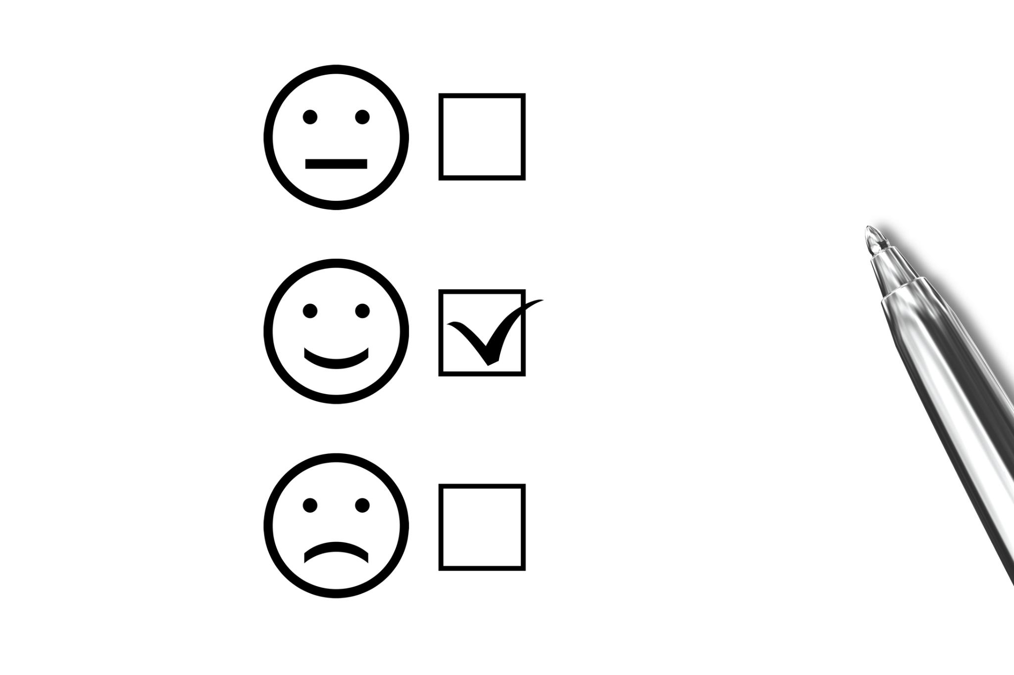
The Four Present Forms
Notes:
This slide reviews the four present tense forms, which most B2 learners already recognise but may not fully control. The present simple is used for facts, habits, routines, and permanent situations, such as daily activities or general truths. The present continuous focuses on actions in progress around now or temporary situations, often with a sense of change or development. The present perfect introduces a different way of thinking about time, linking past actions to the present moment. It is used for experiences, recent actions with present relevance, and situations that started in the past and continue now. The present perfect continuous shifts the focus further towards duration and ongoing activity, emphasising how long something has been happening rather than its completion. At B2 level, learners should be encouraged to compare these forms directly and notice contrasts in meaning rather than treating them as interchangeable. Typical problem areas include overusing the present simple instead of the present perfect and confusion between the present perfect and present perfect continuous. This slide consolidates the forms as part of a single present-time system, reinforcing the idea that aspect choice reflects meaning, not just grammar rules.

Slide 5
Present Simple Usage
Used for facts, habits, routines, and permanent situations like daily activities or general truths.
Present Continuous Usage
Focuses on actions in progress now, temporary situations, and ongoing change or development.
Present Perfect Simple Usage
Links past actions to the present, used for experiences, recent actions, and ongoing situations.
Present Perfect Continuous Usage
Emphasizes duration and ongoing activity, focusing on how long an action has been happening.

Slide 6
Past Tenses
Notes:
The Four Past Forms

Slide 7

The Four Past Forms
Notes:
The past tense system mirrors the present system in structure, which helps learners see English grammar as consistent rather than irregular. The past simple is used for finished actions at a definite time in the past, often with time expressions such as yesterday, last week, or in 2020. The past continuous describes actions in progress at a specific moment in the past or provides background information in narratives. The past perfect allows speakers to show that one past action happened before another past action, creating clear time relationships in storytelling and explanation. The past perfect continuous again highlights duration and ongoing activity before a past point, often explaining causes or background reasons. At B2 level, learners should be able to use these forms in combination, particularly in narratives, reports, and spoken anecdotes. Common difficulties include overusing the past simple and avoiding the past perfect, which can lead to unclear timelines. Presenting these four forms together reinforces the repeating aspect pattern and supports more accurate sequencing of events.

Slide 8
Past Simple Usage
Used for finished actions at a definite time in the past with clear time expressions.
Past Continuous Usage
Describes actions in progress at a specific past moment or background information in stories.
Past Perfect Usage
Shows one past action occurred before another, clarifying time relationships in narratives.
Past Perfect Continuous Usage
Highlights duration and ongoing activity before a past point, explaining causes or backgrounds.

Slide 9
Future with WILL
Notes:
Future Forms Using Will

Slide 10

Future Forms Using Will
Notes:
This slide introduces the four future forms built with will, showing that the future follows the same aspect structure as the present and past. The future simple with will is commonly used for decisions made at the moment of speaking, offers, promises, and predictions based on opinion. The future continuous describes actions that will be in progress at a specific time in the future, often used to sound polite or to set a scene. The future perfect looks forward to a point in the future and describes actions that will be completed before that point, which is useful in planning, deadlines, and goal-setting. The future perfect continuous focuses on duration up to a future moment, although it is relatively rare in everyday communication. For B2 learners, the priority is understanding meaning rather than frequent production of all forms. The key teaching point is that will behaves like a regular auxiliary and fits neatly into the time-plus-aspect system learners already know.

Slide 11
Future Simple with Will
Used for spontaneous decisions, offers, promises, and opinion-based predictions in the future.
Future Continuous Form
Describes ongoing future actions, often for politeness or setting scenes at specific future times.
Future Perfect Usage
Shows actions completed before a future point, useful for planning, deadlines, and goals.
Future Perfect Continuous
Focuses on duration up to a future moment; less common but highlights continuous effort.

Slide 12
Future with BE GOING TO
Notes:
Future Forms Using Going To

Slide 13

Future Forms Using Going To
Notes:
This slide parallels the previous one but uses going to instead of will, which allows the future system to expand from 12 to 16 forms. The going to future simple is typically used for plans made before the moment of speaking and for predictions based on present evidence. The going to continuous and perfect forms follow the same structural logic as other continuous and perfect tenses, although they are much less common in real-life usage. At B2 level, learners should clearly understand the core contrast between will and going to rather than aiming for full productive mastery of all forms. Emphasising that the grammar system allows these forms to exist, even if they are rare, helps learners see English as rule-based and consistent. This also supports receptive skills, as students may encounter such forms in formal writing or exams.

Slide 14
Expansion of Future Forms
Using 'going to' expands the future tense forms from 12 to 16, including simple, continuous, and perfect variations.
Usage for Plans and Predictions
'Going to' future simple is used for pre-made plans and predictions based on current evidence.
Learner Focus at B2 Level
B2 learners should focus on contrasting 'will' and 'going to', understanding system rules rather than mastering all forms.

Slide 15
Will vs Be Going To
Notes:
Choosing the Right Future Form

Slide 16

Choosing the Right Future Form
Notes:
This slide focuses on one of the most important future distinctions at B2 level: choosing between will and going to. Rather than presenting this as a long list of rules, the lesson frames it in terms of speaker perspective. Will is associated with decisions made at the moment of speaking, spontaneous reactions, offers, and predictions based on personal judgement. Going to is used for intentions and plans that exist before the conversation and for predictions based on clear evidence in the present situation. Providing clear contrasts and contextualised examples helps learners make more natural choices in speaking. This distinction is particularly important for fluency and pragmatic accuracy, as misuse can make speech sound unnatural or hesitant. Reinforcing that both forms refer to the future, but express different attitudes or sources of certainty, aligns well with CEFR B2 descriptors.

Slide 17
Role of 'Will'
'Will' expresses spontaneous decisions, offers, and predictions based on personal judgment made at the moment of speaking.
Role of ‘Be going To'
'Going to' conveys pre-existing intentions, plans, and predictions based on clear present evidence.
Fluency and Accuracy
Choosing the correct form improves fluency and pragmatic accuracy, avoiding unnatural or hesitant speech.

Slide 18
Part 1: Identify the tense
I work every day.
_____________________________________________________________________
2. I am working now.
_____________________________________________________________________
3. I have worked here for five years. _____________________________________________________________________
4. I have been working all morning. _____________________________________________________________________
5. I worked yesterday. _____________________________________________________________________
Present simple.
Present continuous.
Present perfect simple.
Present perfect continuous.
Past simple.

Slide 19
6. I was working at 8 pm. ____________________________________________________________________
7. I had worked before he arrived. ____________________________________________________________________
8. I had been working for hours. ____________________________________________________________________
9. I will work tomorrow. ____________________________________________________________________
10. I will be working at 8 pm. ____________________________________________________________________
Past continuous.
Past perfect simple.
Past perfect continuous.
Future simple (will).
Future continuous (will).

Slide 20
11. I will have worked.
_________________________________________________________________________________
12. I will have been working for twenty years. _________________________________________________________________________________
13. I am going to travel tomorrow.
_________________________________________________________________________________
14. I am going to be working later. _________________________________________________________________________________
15. I am going to have finished by 6 pm. _________________________________________________________________________________
16. Be careful! Don’t do that! Stop! (Strictly speaking not a tense.)
_________________________________________________________________________________
Future perfect simple (will).
Future perfect continuous (will).
Future simple (be going to).
Future continuous (be going to).
Future perfect simple (be going to).
Imperative.

Slide 21
Part 2: Choose will or be going to
1. Look at the clouds! It ______________________________________ rain.
2. I think I _______________________________________ call him now.
3. We have already decided. We __________________________ move house next year.
4. Wait! I ______________________________________ help you with that.
is going to rain
’ll
’re going to
’ll

Slide 22
Part 3: Sentence transformation
1. Change to past: I am working. _________________________________________________________________
2. Change to present perfect simple: I work here. _________________________________________________________________
3. Change to future (will): I finish at 5. _________________________________________________________________
4. Change to be going to: I will start tomorrow. _________________________________________________________________
I was working.
I have worked here.
I will finish at 5.
I am going to start tomorrow.

Slide 23
Part 4: Imperative
1. Make an instruction: (sit / down) _______________________________________________________________________
2. Make a negative instruction: (not/open/door) ______________________________________________________________________
3. Make a polite instruction: (please / listen) _______________________________________________________________________
4. Give an instruction with be: (be/careful) _______________________________________________________________________
(Please) sit down.
(Please) do not open the door.
Please listen.
Please be careful.

Slide 24
1. Gap‑Fill: Active → Passive
Instructions
Complete the sentences in the passive. Use the correct form of BE + past participle.

Slide 25
🔹 Present / Past
They build houses every year.
Houses ___________________________________________________________ every year.
They are repairing the road.
The road ______________________________________________________________________.
They have finished the project.
The project ___________________________________________________________________.
They built the bridge last year.
The bridge ___________________________________________________________________.
They were cleaning the room.
The room _____________________________________________________________________.
They had completed the work.
The work _____________________________________________________________________.
are built.
is being repaired.
has been finished.
was built last year
was being cleaned
had been completed

Slide 26
🔹 Future (WILL)
They will build a new school.
A new school __________________________________________________.
They will be checking the equipment.
The equipment ________________________________________________.
They will have finished the project.
The project ____________________________________________________.
will be built
will be being checked
will have been finished

Slide 27
🔹 Future (BE GOING TO)
They are going to build a hospital.
A hospital _______________________________________________________.
They are going to be repairing the road.
The road _________________________________________________________.
They are going to have completed the work.
The work ________________________________________________________.
is going to be built
is going to be being repaired
is going to have been completed

Slide 28
🔹 Modals + passive
They can solve the problem.
The problem ____________________________________________________.
They must finish the work today.
They had better solve the problem.
The problem ____________________________________________________.
They must finish the work today.
The work ________________________________________________________.
Close the door.
Let the door remain _____________________________________________.
can be solved
had better be solved
must be completed
closed

